Slide 1


INSTITUTE OF TECHNOLOGY OF CAMBODIA
DEPARTMENT OF TELECOMMUNICATION AND NETWORK ENGINEERING
Report of Internship
‘IoT Platform Cloud Storage for Agricultural Application’
Student : Mr. VANNAK Sovannroth
ID : e20171016
Group : I4-GTR
Advisor : Mr. HEL Chanthan
2020-2021

Slide 2
Outline
01
Table of Weekly Activities
02
Introduction
03
Methodology and Methods
04
Result and Discussion
05
Conclusions
PAGE 01

Slide 3
Table of Weekly Activities
Week | Activities
1 | Installation Nodejs & MongoDB (Shell and Compass) Performing CRUD on Shell and Compass Testing connection locally/cloud on MongoDB
2 | Starting to build sample backend Transmitting and fetching data to/from the Database Creating Login and Signup (Email and password)
3 | Learning HTML, CSS, and JS language Learning SQL and PHP language Learning Bootstrap 4
4 | Learning Laravel 7 Install wampserver & Run Laravel 7 with MySQL (Database) Choose free template Bootstrap 4 for Frontend & Backend
5 | Installation Laravel Module for Backend and Frontend Starting to build module backend for project. Creating users Login, Signup, & reset password
6 | Create CRUD for Users login Create CRUD for Lab information Create CRUD for upload file (picture)
7 | Starting design dashboard Apply sample dashboard from bootstrap 4 Learning how to use platform bootstrap 4
8 | Testing sample line charts on dashboard Getting data from database view on dashboard
9 | Starting to build sample frontend Connect frontend to backend Choose Flutter or React Native for build Mobile application.
10 | Installation Flutter & Android Studio and coding Start build sample UI on project Starting build line charts on Mobile application
PAGE 02

Slide 4
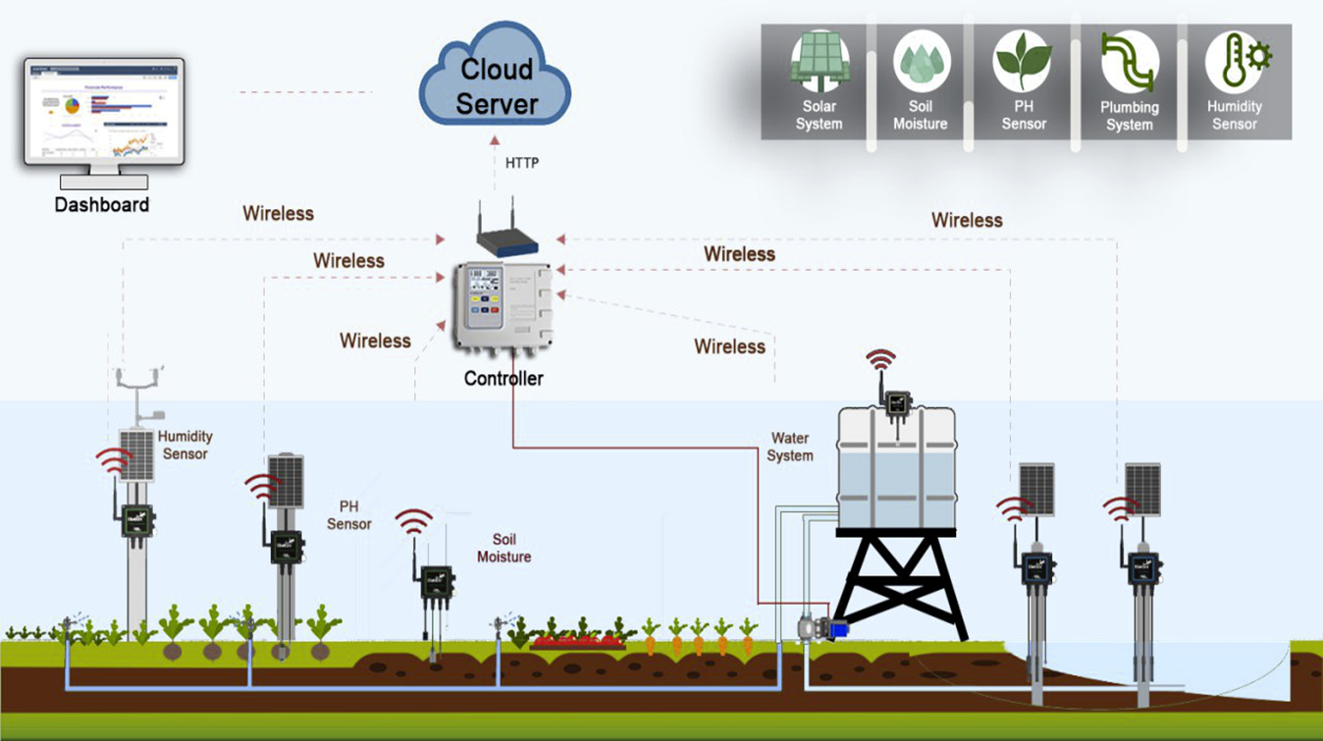
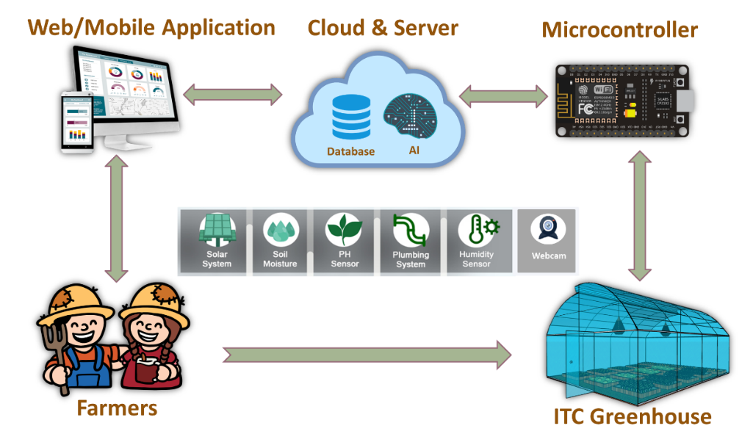
Introduction
Introduction
Methodology and Methods
Result and Discussion
Conclusions
The research focuses on IoT platform cloud storage for agricultural application:
IoT platform cloud storage is a part of smart irrigation project, it will be designed for managing all data of projects, over the internet.
Web/mobile application will be developed that it is an IoT analytics platform service that allows us to aggregate, visualize and analyze live data streams in the cloud.
It provides instant visualizations of data posted by devices, and view data value of temperature, soil moisture, humidity, pH, and solar radiation on dashboard as line charts and control Motor ON/OFF or Scheduling.
System Architecture of Smart Irrigation
The Proposed Smart Farm
PAGE 03

Slide 5
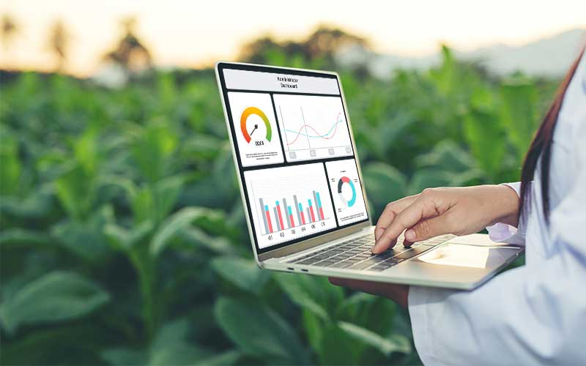
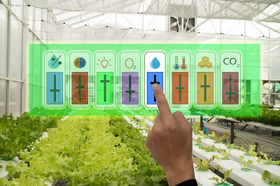
Objectives
Introduction
Methodology and Methods
Result and Discussion
Conclusions
When famers use this system, it will improve the yield due to they can get the details about irrigation based on control moisture, and temperature that give them easy to maintain and apply pesticide for their farm via latest updates on web/app application.
This will ensure an environment conducive to the growth of plants at any time, from anywhere, through the Internet.
They will able to manually or automatically control the watering pump and airflow fan to create suitable environment for growing the plants.
The real-time environmental parameters are able to be displayed and controlled off-line or on-line.
Live data on dashboard
Remote Control Sensors
PAGE 04

Slide 6
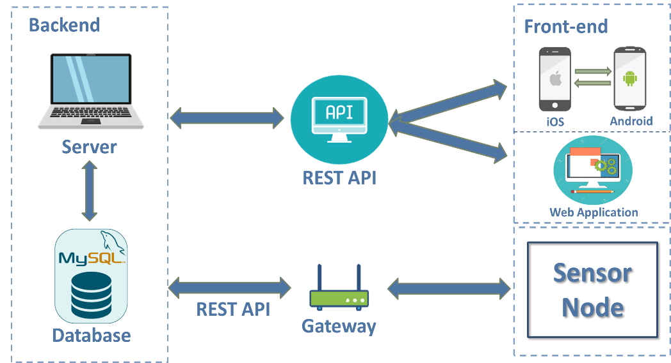
Methodology and Methods
Introduction
Methodology and Methods
Result and Discussion
Conclusions
This work aims to develop both the backend and frontend.
The Backend will be developed for communication to frontend, data collections, and manages the data in the database that it also allows users to access information from the server.
Frontend will be developed to monitor the data of each project/farm through web application that is compatible on both mobile and computer and plot the information from the database.
Architecture of IoT Cloud Storage
PAGE 05

Slide 7
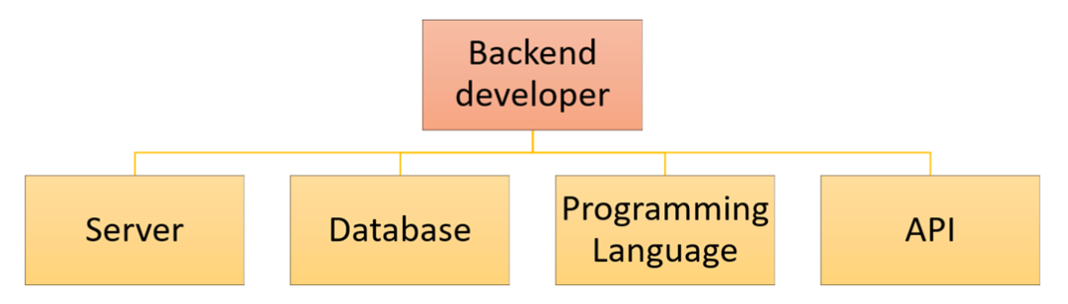
Backend Development
Introduction
Methodology and Methods
Result and Discussion
Conclusions
Architecture of Backend Development
SQL Server: is primarily designed and developed to compete with MySQL and Oracle database.
Database: is a collection of objects such as tables, views, stored procedures, triggers, functions, etc.
Programming Language: using PHP language as main programming language.
Rest API: allows frontend to do CRUD (CREATE/READ/UPLOAD/DELECT) operations on the data information and API carry out the info through HTTP methods.
PAGE 06

Slide 8
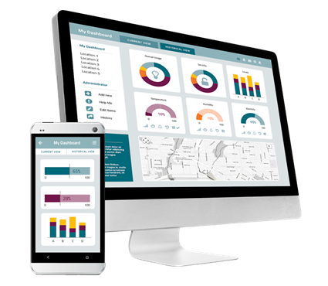
Frontend Development
Introduction
Methodology and Methods
Result and Discussion
Conclusions
Web & Mobile Application
Web application will be developed by using Laravel 7 framework (using PHP language) with Bootstrap 4, and to develop a web application, the code is written in HTML, CSS, and JS. The main goal in the web application is to communicate with the server, be able to send and collect data from database.
Mobile application will be developed by using Flutter framework with Dart language that it will be able to develop both iOS and Android.
REST API is used for communication between web application, mobile application, database, server, and Sensor Node.
PAGE 07

Slide 9
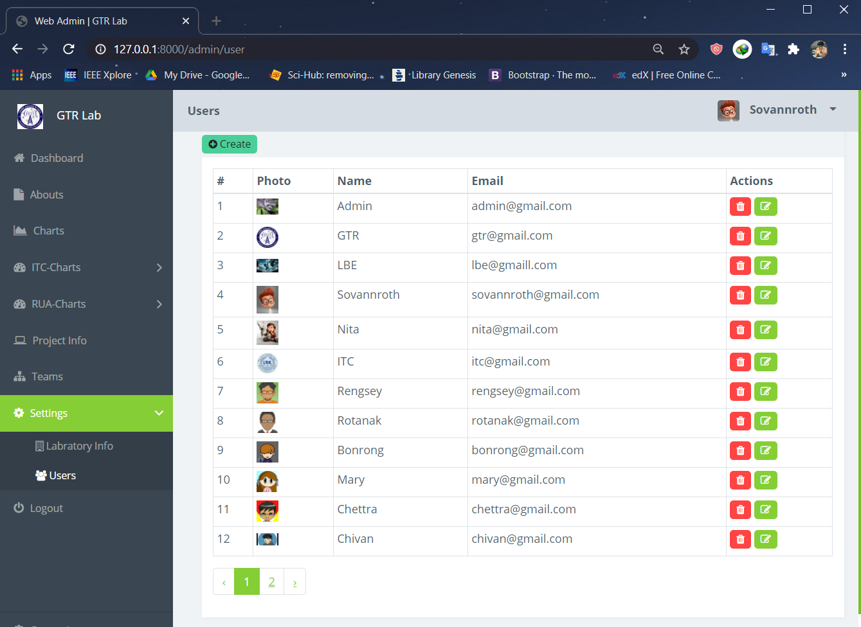
Result and Discussion
Introduction
Methodology and Methods
Result and Discussion
Conclusions
On backend development:
Create account
Manage (CRUD)
Authentication (Email & Password)
On frontend development:
View data
Interface of User Login
PAGE 08

Slide 10
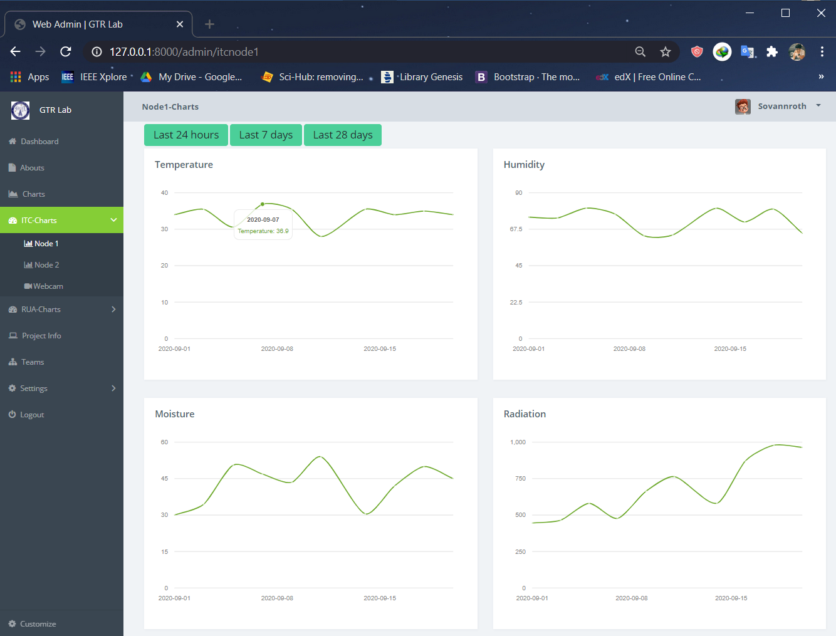
Viewing data on line charts
Introduction
Methodology and Methods
Result and Discussion
Conclusions
Interface of ITC-Charts
PAGE 09

Slide 11
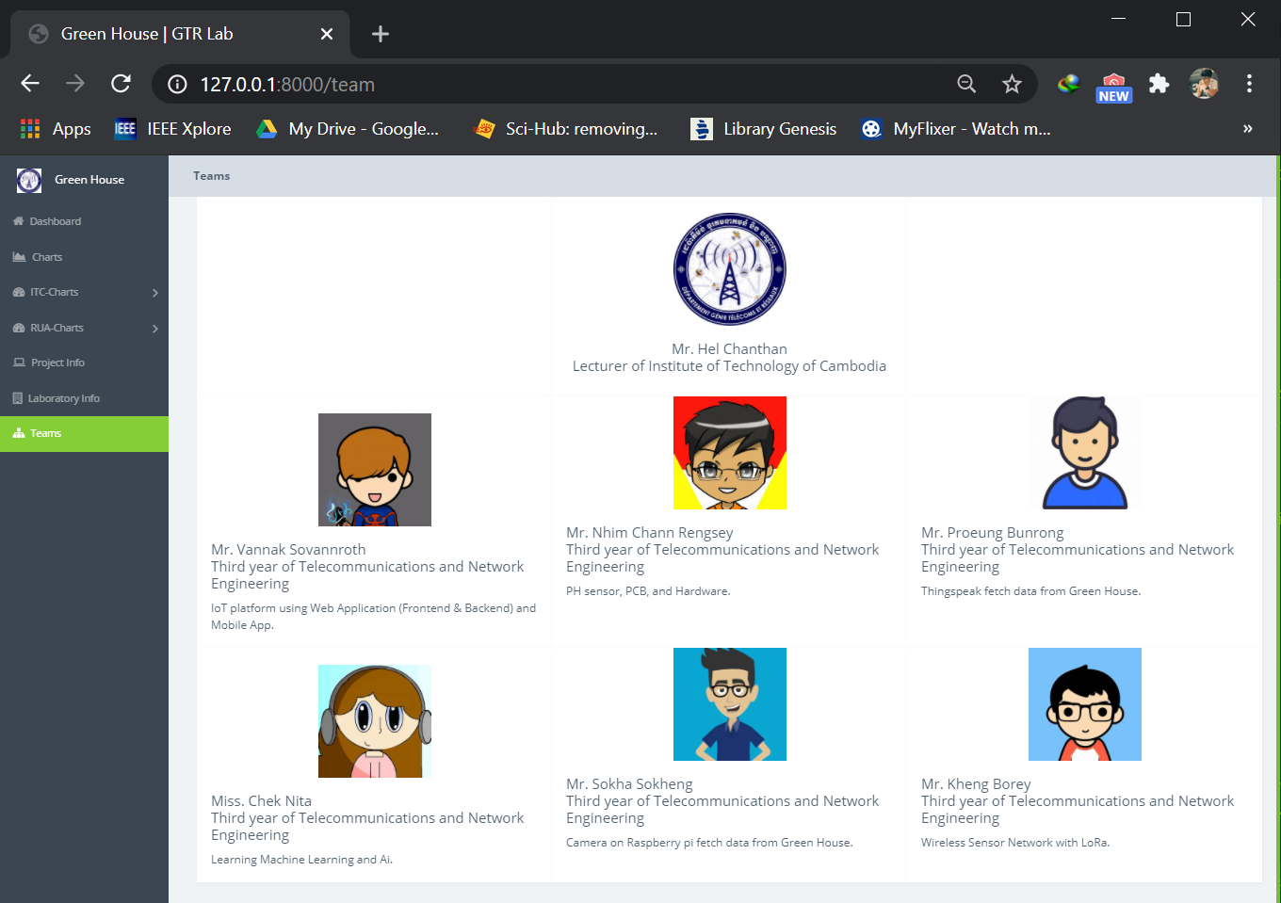
Team Information
Introduction
Methodology and Methods
Result and Discussion
Conclusions
Interface of Team Information
PAGE 10

Slide 12
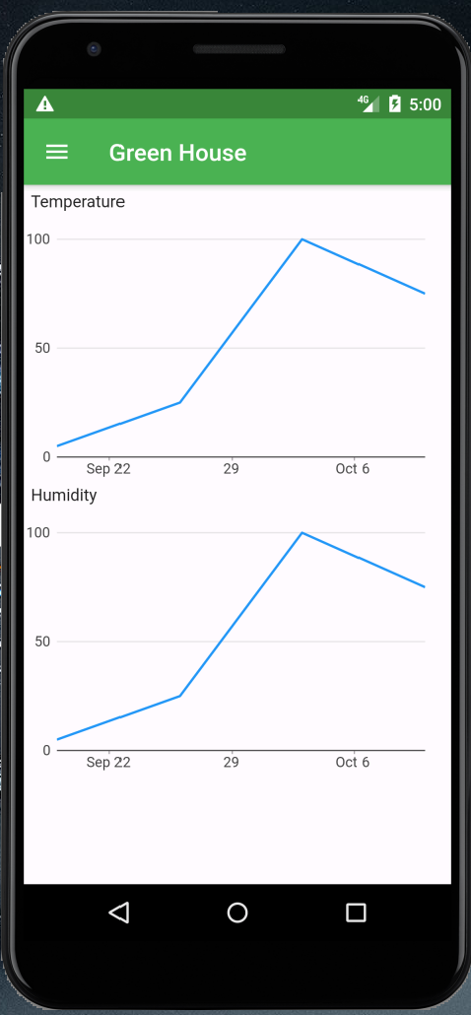
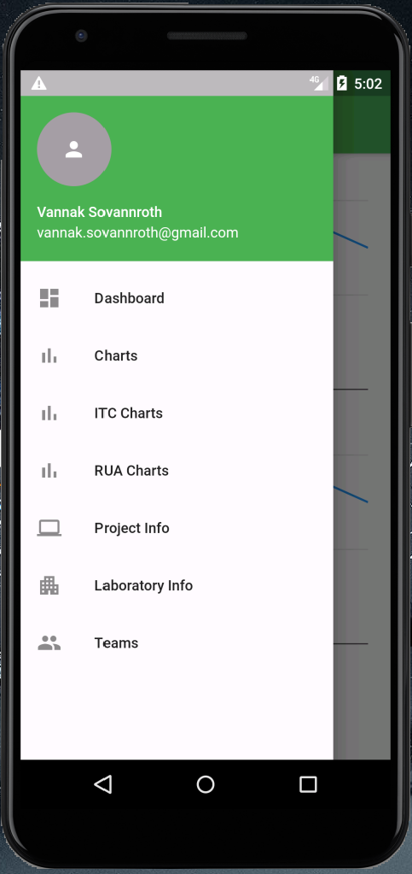
Mobile Application
Introduction
Methodology and Methods
Result and Discussion
Conclusions
Interface of Greenhouse Information on iOS/Android
PAGE 11

Slide 13
Conclusions
Introduction
Methodology and Methods
Result and Discussion
Conclusions
Future Development
Real time monitoring: Connect to devices and data collection (Development board: Arduino, RPI and new hardware design
Real time controlling: ON/OFF and Scheduling
Data storage: Organization data in database
1 database for 1 project for data storage
Database for user information (username, password)
Database for device information
Database for project API key/Token
Dashboard for control and monitoring both WEB and APP: (Should discuss in backend or frontend)
Allow user registration and login via frontend
Display project information: Overview, Device list, graph, setting, API key and API link to server .
Display will be automatically assigned to the user from the platform (Admin assign)
Communication protocol: Device to gateway and gateway to Platform
Device to gateway: Lora, Zigbee, WiFi
Gateway to Platform: HTTP or HTTPS
Security
Secured device while connect to platform: use device registration (Serial number, MAC address)
Secure the platform: Not consider yet
Secure the data and network: use Token an API for authentication
API server script
Used for communicating with API client code from device
PAGE 12

Slide 14
Thank You!

